Slide 1
Chapter 7
Expressions and Assignment Statements

Slide 2
Chapter 7 Topics
Introduction
Arithmetic Expressions
Overloaded Operators
Type Conversions
Relational and Boolean Expressions
Short-Circuit Evaluation
Assignment Statements
Mixed-Mode Assignment

Slide 3
Introduction
Expressions are the fundamental means of specifying computations in a programming language
To understand expression evaluation, need to be familiar with the orders of operator and operand evaluation
The operator evaluation order of expressions is dictated by the associativity and precedence rules of the language.

Slide 4
Arithmetic Expressions
Arithmetic evaluation was one of the motivations for the development of the first programming languages
Most of the characteristics of arithmetic expressions in programming languages were inherited from mathematics
Arithmetic expressions consist of operators, operands, parentheses, and function calls

Slide 5
Arithmetic Expressions: Operators
A unary operator has one operand
A binary operator has two operands
A ternary operator has three operands

Slide 6
Arithmetic Expressions: unary
The unary operators operate on a single operand and following are the examples of Unary operators:
The increment (++) and decrement (--) operators.
The unary minus (-) operator.
The logical not (!) operator.

Slide 7
Arithmetic Expressions: binary
A binary operator is an operator that operates on two operands and manipulates them to return a result. Operators are represented by special characters or by keywords and provide an easy way to compare numerical values or character strings. Binary operators are presented in the form: Operand1 Operator Operand2

Slide 8
Arithmetic Expressions: binary
Some common binary operators in computing include:
Equal (==) , Not equal (!=)
Less than (<), Greater than (>)
Greater than or equal to (>=)
Less than or equal to (<=)
Logical AND (&&), Logical OR (||)
Plus (+), Minus (-), Multiplication (*), Divide (/)

Slide 9
Arithmetic Expressions: ternary
It takes three arguments. The first one is a comparison, the second is the result upon a true comparison, and the third is the result upon a false comparison.
think of writing an if-else statement..
Helps to increase the readability and reduce the amount of lines in your code
a ? b : c evaluates to b if the value of a is true, and otherwise to c.

Slide 10
Arithmetic Expressions: Design Issues
Design issues for arithmetic expressions
Operator precedence rules?
Operator associativity rules?
Order of operand evaluation?
Operand evaluation side effects?
Operator overloading?
Type mixing in expressions?

Slide 11
Arithmetic Expressions: Operator Precedence Rules
Consider the following expression:
a + b * c
Suppose the variables a, b, and c have the values 3, 4, and 5, respectively.
If evaluated left to right (the addition first and then the multiplication), the result is 35.
If evaluated right to left, the result is 23.

Slide 12
Arithmetic Expressions: Operator Precedence Rules
Mathematicians long ago developed the concept of placing operators in a hierarchy of evaluation priorities
The operator precedence rules of the common imperative languages are nearly all the same, because they are based on those of mathematics.

Slide 13
Arithmetic Expressions: Operator Precedence Rules
The operator precedence rules for expression evaluation define the order in which “adjacent” operators of different precedence levels are evaluated
Typical precedence levels
parentheses
unary operators
** (if the language supports it)
*, /
+, -

Slide 14
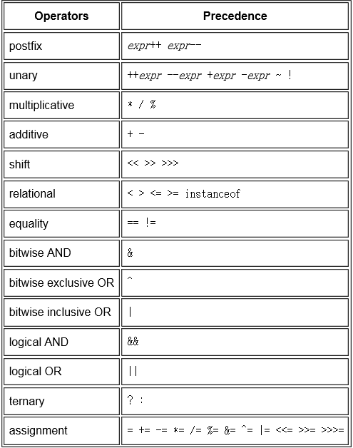
Operator Precedence in Java

Slide 15
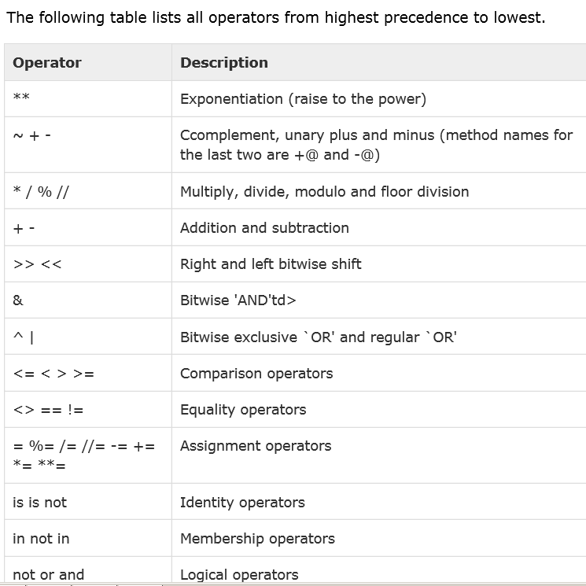
Operator Precedence in Phyton

Slide 16
Arithmetic Expressions: Operator Precedence Rules
C-Based Languages
Highest postfix ++, --
prefix ++, --, unary +, -
*, /, %
Lowest binary +, -

Slide 17
Arithmetic Expressions: Operator Associativity Rule
Consider the following expression:
a - b + c - d
If the addition and subtraction operators have the same level of precedence, as they do in programming languages, the precedence rules say nothing about the order of evaluation of the operators in this expression
the question of which operator is evaluated first
is answered by the associativity rules of the language.

Slide 18
Arithmetic Expressions: Operator Associativity Rule
An operator can have either left or right associativity, meaning that when there are two adjacent operators with the same precedence, the left operator is evaluated first or the right operator is evaluated first, respectively.
Associativity in common languages is left to right, except that the exponentiation operator sometimes associates right to left.

Slide 19

Arithmetic Expressions: Operator Associativity Rule
a=7, b=5, c=4, d=3,
a - b + c – d=?
a + b * c=?
a+(-c)=?
5a
y = c + --- + b
2

Slide 20
Arithmetic Expressions: Operator Associativity Rule
in APL (A Programming Language), all operators have the same level of precedence, which is right to left for all operators.
A x B + C
the addition operator is evaluated first, followed by the multiplication operator
If A were 3, B were 4, and C were 5, then the value of this APL expression would be 27.

Slide 21
APL, a programming language
Developed in the 1960s by Ken Iverson.
It uses a large range of special graphic symbols to represent most functions and operators.
It has been an important influence on the development of concept modeling, spreadsheets, functional programming, and computer math packages.
It is still used today for certain applications.

Slide 22
Arithmetic Expressions: Paranthesis
Precedence and associativity rules can be overriden with parentheses
Programmers can alter the precedence and associativity rules by placing parentheses
in expressions.
A parenthesized part of an expression has precedence over its adjacent unparenthesized parts.
(A + B) * C

Slide 23
Arithmetic Expressions: Paranthesis
k=x*y+x*x/5*y
k=x*y+x*x/(5*y)

Slide 24
Arithmetic Expressions: Conditional Expressions
Conditional Expressions
C-based languages, more convenient
An example:
average = (count == 0)? 0 : sum / count
Evaluates as if written as follows:
if (count == 0)
average = 0
else
average = sum /count

Slide 25
Arithmetic Expressions: Conditional Expressions
expression_1 ? expression_2 : expression_3
If expression_1 evaluates to true, the value of the whole expression is the value of expression_2;
otherwise, it is the value of expression_3

Slide 26
Arithmetic Expressions: Operand Evaluation Order
Operand evaluation order
Variables: fetch the value from memory
Constants: sometimes a fetch from memory; sometimes the constant is in the machine language instruction
Parenthesized expressions: evaluate all operands and operators first
The most interesting case is when an operand is a function call

Slide 27
Arithmetic Expressions: Potentials for Side Effects
Functional side effects: when a function changes a two-way parameter or a global variable
Problem with functional side effects: When a function referenced in an expression alters another operand of the expression; e.g., for a parameter change:

Slide 28
Arithmetic Expressions: Potentials for Side Effects
#include <iostream>
int a = 5;
int fun1() {
a = 17;
return 3; }
using namespace std;
int main() {
cout<<"\n a="<<a;
a = a + fun1();
cout<<"\n a="<<a;
a=5
a=20

Slide 29
Functional Side Effects
possible solution to the problem
Write the language definition to disallow functional side effects
No two-way parameters in functions
No non-local references in functions
Advantage: it works!
Disadvantage: inflexibility of one-way parameters and lack of non-local references

Slide 30
Referential Transparency
A program has the property of referential transparency if any two expressions in the program that have the same value can be substituted for one another anywhere in the program, without affecting the action of the program
The value of a referentially transparent function depends entirely on its parameters

Slide 31
Referential Transparency
result1 = (fun(a) + b) / (fun(a) – c);
temp = fun(a);
result2 = (temp + b) / (temp – c);
If the function fun has no side effects, result1 and result2 will be equal,
Suppose fun has the side effect of adding 1 to either b or c. Then result1 would not be equal to result2. So, that side effect violates the referential transparency of the program in which the code appears.

Slide 32
Referential Transparency (continued)
int b = 4, f = 5; /* global variables */
int fun1(int a) {a = 17;b=b+2;return a; }
int fun2() {f = f + 1;return f; }
int main() {
int a=6, d=12, temp; float result1, result2;
result1 = (fun1(a) + b) / (fun1(a) - d);
cout<<"\n a= “<<a<<“b="<<b<<“d="<<d<<“result="<< result1;
temp = fun1(a); result2 = (temp + b) / (temp - d);
cout<<"\na=“<<a<<“b="<<b<<“d="<<d<<“temp="<<temp<< " result2= "<< result2;
cout<<"\n before f = "<<f;
f = f + fun2();
cout<<"\n after f = "<<f;

Slide 33

Referential Transparency (continued)

Slide 34
Overloaded Operators
Use of an operator for more than one purpose is called operator overloading
+ addition for int and float and
catenation (str3 = str1 + str2;)
& address (x = &y) and
bitwise logical AND operation (a & b)
* Multiplication and
pointer sign (int *ptr;)

Slide 35
Overloaded Operators
Some are potential trouble
Loss of compiler error detection (omission of an operand should be a detectable error)
Some loss of readability

Slide 36
Overloaded Operators (continued)
user-defined overloaded operators
if + and * are overloaded for a matrix, then
A * B + C * D
can be used instead of
MatrixAdd(MatrixMult(A, B), MatrixMult(C,D);

Slide 37
Overloaded Operators (continued)
C++, C#, and F# allow user-defined overloaded operators
When sensibly used, such operators can be an aid to readability (avoid method calls, expressions appear natural)
Potential problems:
Users can define nonsense operations
Readability may suffer, even when the operators make sense

Slide 38

Type Conversions
A narrowing conversion is one that converts an object to a type that cannot include all of the values of the original type e.g., double to float
double d=1234567890;
float f;
f = d;
printf("\n d = %15.5f \n f = %15.5f",d,f);
if (f > d) printf("\n f greater");

Slide 39

Type Conversions
A widening conversion is one in which an object is converted to a type that can include at least approximations to all of the values of the original type e.g., int to float
int v=1234567890;
cout<<"\n integer value v="<<v;
float d ;
d = v;
cout<<"\n float value d="<<d;

Slide 40
Type Conversions
Widening conversions can result in reduced accuracy.
In integer-to-floating-point conversions some precision may be lost.
In most case, integers and floating-points are stored in 32 bits, but integer with nine decimal digits of precision, floating with only about seven decimal digits of precision, so widening can result in the loss of two digits of precision

Slide 41
Explicit Type Conversions
Most languages provide some capability for doing explicit conversions.
In the C-based languages, explicit type conversions are called casts.
The desired type is placed in parentheses just before the expression to be converted
(int) angle

Slide 42

Explicit Type Conversions
int n=50, t=100;
printf("\n percentage=%d ",n/t*100);
printf("\n percentage=%f ",n/t*100);
printf("\n percentage=%f ",(float)n/t*100);

Slide 43
Errors in Expressions
A number of errors can occur during expression evaluation.
Causes
Inherent limitations of arithmetic e.g., division by zero
printf("\n %f",a/0);
Limitations of computer arithmetic e.g. overflow
int a=123456789012345;
printf("\n %d",a);
run-time error, ,interruption for C/C++

Slide 44
Relational Expressions
A relational operator is an operator that compares the values of its two operands by using one relational operator
Use relational operators and operands of various types
Operator symbols used vary somewhat among languages (Not equal is !=, /=, ~=, .NE., <>, #)
Result?
if (a = b)
printf("\n True"); ⬅
else
printf("\n False");

Slide 45
Relational Expressions
JavaScript and PHP have two additional relational operator, === and !==. Similar to == and !=, except that they do not coerce their operands

Slide 46
Relational Expressions
The relational operators always have lower precedence than the arithmetic
operators, so that in expressions such as
a + 1 > 2 * b
the arithmetic expressions are evaluated first.
int a=2, b=1;
if (a + 1 > 2 * b)
printf("\n True");
else
printf("\n False");

Slide 47
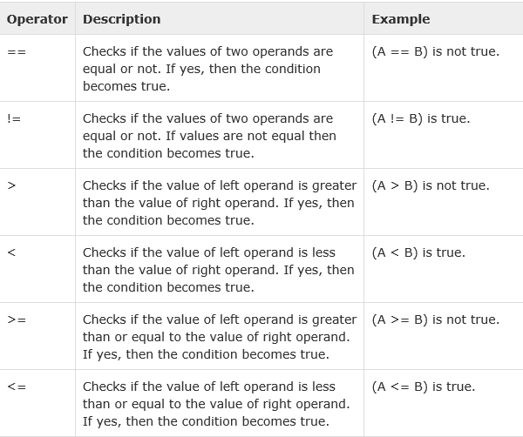
Relational Operators in C

Slide 48
Boolean Expressions
Boolean expressions consist of Boolean variables, Boolean constants, relational expressions, and Boolean operators.
The operators include those AND, OR, and NOT operations, and sometimes for exclusive OR and equivalence.
Boolean operators usually take only Boolean operands (Boolean variables, Boolean literals, or relational expressions) and produce Boolean values.

Slide 49
Boolean Expressions
Boolean Expressions
Operands are Boolean and the result is Boolean
Example in C++, result is x=0
bool x=0;
cout<<" x = "<<x;
C89 has no Boolean type--it uses int type with 0 for false and nonzero for true
the C-based languages assign a higher precedence to AND than OR

Slide 50
Short Circuit Evaluation
An expression in which the result is determined without evaluating all of the operands and/or operators
Example: (13 * a) * (b / 13 – 1)
If a is zero, there is no need to evaluate
(b /13 - 1)
The second argument is executed or evaluated only if the first argument does not suffice to determine the value of the expression:

Slide 51
Short Circuit Evaluation
The value of the Boolean expression
(a >= 0) && (b < 10)
is independent of the second relational expression
if a < 0, (FALSE && (b < 10)) is FALSE for all values of b. So, when a a < 0, there is no need to evaluate b, the constant 10, the second relational expression, or the && operation.

Slide 52
Short Circuit Evaluation
a && b => if a=false, overall value is false
a || b => if a=true, overall value is true
Problem with non-short-circuit evaluation
index = 0;
while (index <= length) && (LIST[index] != value)
index++;
When index=length, LIST[index] will cause an indexing problem (assuming LIST is length - 1 long)

Slide 53
Short Circuit Evaluation (continued)
Short-circuit evaluation exposes the potential problem of side effects in expressions (a > b) || (b++ / 3)
b is changed (in the second arithmetic expression) only when a <= b. Because if (a > b) the second expression is not executed.
If the programmer assumed b would be changed every time this expression is evaluated during execution (and the program’s correctness
depends on it), the program will fail.

Slide 54
Short Circuit Evaluation
Advantages;
It can eliminate expensive computation in the second argument.
It permits a construct where the first expression guarantees a condition without which the second expression may cause a run-time error. Avoiding undesired side effects of the second argument

Slide 55
Short Circuit Evaluation (continued)
C, C++, and Java: use short-circuit evaluation for the usual Boolean operators (&& and ||), but also provide bitwise Boolean operators that are not short circuit (& and |)
All logic operators in Ruby, Perl, ML, F#, and Python are short-circuit evaluated
Ada: programmer can specify either (short-circuit is specified with and then and or else)

Slide 56
Assignment Statements
The assignment statement is one of the central constructs in imperative languages.
It provides the mechanism by which the user can dynamically change the values to variables
Nearly all programming languages use the equal sign for the assignment operator.
All of these must use something different from an equal sign for the equality relational operator to avoid confusion with their assignment operator.

Slide 57
Assignment Statements
The general syntax
<target_var> <assign_operator> <expression>
The assignment operator
= Fortran, BASIC, the C-based languages
:= Ada, PAscal
= can be bad when it is overloaded for the relational operator for equality (that’s why the C-based languages use == as the relational operator)

Slide 58
Assignment Statements: Conditional Targets
Conditional targets (Perl) ($flag ? $total : $subtotal) = 0
Which is equivalent to
if ($flag){
$total = 0
} else {
$subtotal = 0
}

Slide 59
Assignment Statements: Compound Assignment Operators
A shorthand method of specifying a commonly needed form of assignment
The destination variable appears as the first operand in the expression on the right side
Introduced in ALGOL; adopted by C and the C-based languaes as well as Perl, JavaScript, Python, and Ruby
Example
a = a + b can be written as a += b

Slide 60
Assignment Statements: Unary Assignment Operators
The C-based languages, Perl, and JavaScript include two special unary arithmetic operators .
They combine increment (++) and decrement (––) operations with assignment.
They can be used either in expressions or to form stand-alone single-operator assignment statements.

Slide 61
Assignment Statements: Unary Assignment Operators
They can appear either as prefix or postfix operators.
Examples
count incremented, then assigned to sum
sum = ++count is equal to
count = count + 1; sum = count;
count assigned to sum, then incremented
sum = count++ is equal to
sum = count; count = count + 1;

Slide 62
Assignment Statements: Unary Assignment Operators
count incremented
count++ is equal to
count = count + 1;
count incremented then negated
-count++ is equal to
count = count + 1;
count = count * (-1);

Slide 63
Assignment as an Expression
In the C-based languages, Perl, and JavaScript, the assignment statement produces a result and can be used as an operand
while ((ch = getchar())!= EOF){…}
ch = getchar() is carried out; the result (assigned to ch) is used as a conditional value for the while statement

Slide 64
Assignment as an Expression
while ((ch = getchar())!= EOF){…}
Without the parentheses, the new character would be compared with EOF first. Then, the result of that comparison, either 0 or 1, would be assigned to ch.
Disadvantage: difficult to read and understand

Slide 65
Assignment as an Expression
For example, the expression
a = b + (c = d / b) - 1
denotes the instructions
Assign d / b to c
Assign b + c to temp
Assign temp - 1 to a
b=3, c=4, d=5; a=>3

Slide 66
Assignment as an Expression
the treatment of the assignment operator as any other binary operator allows the effect of multiple-target assignments, such as
sum = count = total = 0;
in which count is first assigned the zero, and then count’s value is assigned to sum.
This form of multiple-target assignments is also legal in Python.

Slide 67
Assignment as an Expression
There is a loss of error detection in the C design of the assignment operation that frequently leads to program errors.
If we type
if (x = y) ... instead of if (x == y) ...
It is not detectable as an error by the compiler.
The value of y is assigned to x, instead of comparison.
It is an error in Java

Slide 68
Multiple Assignments
Perl, Ruby, and Lua allow multiple-target multiple-source assignments
($first, $second, $third) = (20, 30, 40);
The semantics is that 20 is assigned to $first, 40 is assigned to $second, and 60 is assigned to $third.
Also, the following is legal and performs an interchange:
($first, $second) = ($second, $first);

Slide 69
Mixed-Mode Assignment
Assignment statements can also be mixed-mode
In Fortran, C, Perl, and C++, any numeric type value can be assigned to any numeric type variable
In Java and C#, only widening assignment coercions are done
In Ada, there is no assignment coercion

